Slide 1

Process Mining Virtual Internship
by
S. Vasim Subahani
Roll No.214G1A32B7
Department of Computer Science and Engineering (Data Science)
Srinivasa Ramanujan Institute of Technology
(Affiliated to JNTUA & Approved by AICTE) (Accredited by NAAC with ‘A’ Grade & Accredited by NBA (EEE, ECE & CSE)
Rotarypuram Village, B K Samudram Mandal, Ananthapuramu – 515701.
2023 - 2024

Slide 2

Contents
Course Objective
Introduction
Technology
Applications
Modules
Real Time applications
Learning outcomes
GitHub Link
Queries

Slide 3
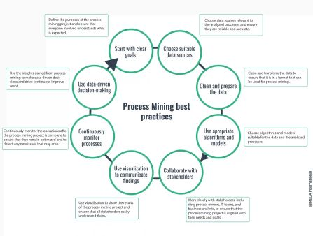
Course Objective
Point 1
Process mining software allows you to view advanced data and visualizations related to your processes, such as the exact time it takes to accomplish various subtasks. Process mining is the latest technology that is transforming businesses as they look to prepare for the future of using data to drive business decisions.
Point 2
This technology can precisely pinpoint
where your process bottlenecks and inefficiencies
are AND offer ideas for automation opportunities.

Slide 4
Introduction
What is Process Mining?
Process mining is a technique to analyze and track processes. In traditional business process management, it is done with process workshops and interviews, which results in an idealized picture of a process.Process mining, however, uses existing data available in corporate information systems and automatically displays the real process.
Process mining benefits
Survey processes everywhere across the enterprise—at high scale and low human effort
Analyze Processes fully and accurately based on the facts
Zero in on bottlenecks, deviations and inefficient processes that should be rethought or automated
Continuously monitor processes and measure improvements
Simplify compliance, with full audit trails
Use in any industry: financial services, telecommunications, manufacturing, healthcare or consumer goods and beyond
Analyze virtually any process in any functional area: contact centers, purchase-to-pay, order-to-cash, and many more

Slide 5
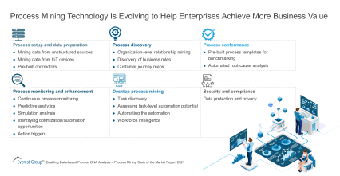
Technology
Automated Process Discovery: This technique involves creating process models from the event data without prior knowledge of the process. Algorithms automatically construct process maps, flowcharts, or Petri nets to visualize how activities are connected and sequences are executed. This provides a baseline understanding of the process.
Conformance Checking: Once a process model is generated, it's compared to the actual event data to identify deviations, non-compliant behaviors, and variations between the modeled process and the real process. This helps in identifying where and why actual processes differ from the intended ones.
Performance Analysis: Process mining evaluates
the performance of processes by analyzing time-related
aspects, such as cycle times, waiting times, and resource
utilization. This enables the identification of bottlenecks,
delays, and areas for improvement.

Slide 6
Contd..
Variant Analysis: Businesses often have multiple paths or variants within a process due to exceptions or different decision points. Variant analysis helps uncover these variations and understand their frequency and impact on overall process efficiency.
Root Cause Analysis: Process mining can help identify the underlying causes of process inefficiencies or deviations. By tracing back to the origin of issues, organizations can take targeted corrective actions.
Predictive Analytics: Some advanced process mining tools incorporate predictive capabilities to forecast potential future process behavior based on historical data. This can assist in proactive decision-making and resource allocation.
Continuous Monitoring: Process mining isn't a one-time analysis; it's a continuous process. Monitoring tools keep track of ongoing processes and provide real-time insights, helping organizations respond promptly to changes and deviations.
Visualization: Visualizations play a crucial role in process mining, offering intuitive representations of complex data. These visualizations include process maps, flowcharts, histograms, and performance metrics.

Slide 7
Contd..
Integration with BPM Systems: Many process mining tools integrate with Business Process Management (BPM) systems, allowing seamless transition from analysis to process optimization and automation.
Machine Learning and AI: Advanced process mining solutions may incorporate machine learning and AI techniques to enhance accuracy, prediction capabilities, and handling of large datasets.
Privacy and Security: As process mining involves sensitive data, ensuring privacy and security is essential. Anonymization techniques may be employed to protect user and business information.
. Types of process mining
Wil van der Aalst, a Dutch computer scientist and professor, is credited with much of the academic research around process mining. Both his research and the above-mentioned manifesto describe three types of process mining, which are discovery, conformance, and enhancement.

Slide 8
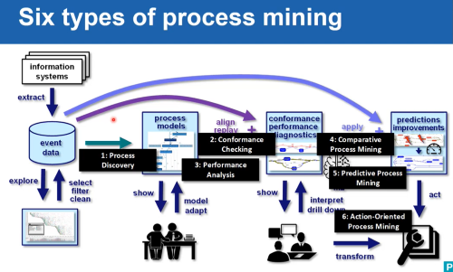
Contd..

Slide 9
Contd..
Discovery: Process discovery uses event log data to create a process model without outside influence. Under this classification, no previous process models would exist to inform the development of a new process model. This type of process mining is the most widely adopted.
Conformance: Conformance checking confirms if the intended process model is reflected in practice. This type of process mining compares a process description to an existing process model based on its event log data, identifying any deviations from the intended model.
Enhancement: This type of process mining has also been referred to as extension, organizational mining, or performance mining. In this class of process mining, additional information is used to improve an existing process model. For example, the output of conformance checking can assist in identifying bottlenecks within a process model, allowing managers to optimize an existing process.

Slide 10
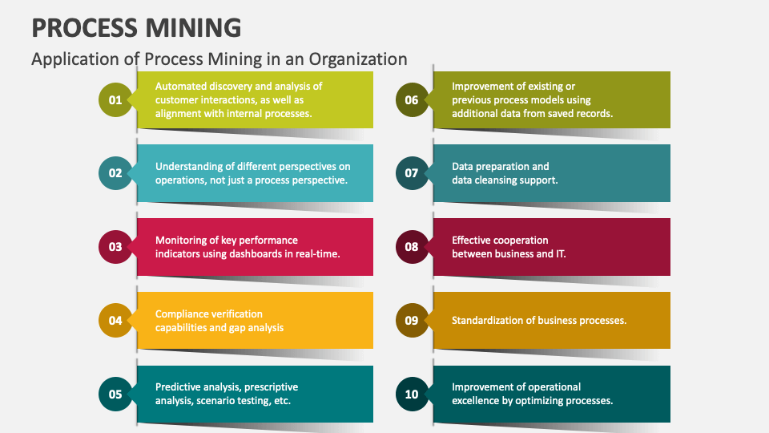
Applications

Slide 11
Contd..
Here are some specific applications of process mining:
1. Process Discovery: Process mining helps uncover the actual flow of processes by analyzing event logs. This can be particularly useful when there's a lack of documentation or when processes are complex. It provides a visual representation of how activities are connected, allowing organizations to understand their processes better.
2. Conformance Checking: Process mining compares the actual execution of processes with their intended design. This helps identify deviations, inefficiencies, or non-compliance.By comparing the expected sequence of activity with what actually happens, organizations can spot discrepancies and take corrective actions.
3. Performance Analysis: Process mining allows the identification of bottlenecks and inefficiencies in processes. It can help answer questions like where delays occur, which steps take the most time, and where resources are being underutilized. This information is crucial for optimizing processes.

Slide 12
Contd..
4. Root Cause Analysis: When problems or deviations are detected in a process, process mining can help trace back to the root causes. This can lead to targeted improvements that address the underlying issues, rather than just the symptoms.
5. Predictive Analytics: By analyzing historical data, process mining can also provide insights into future trends or potential issues. This can help organizations take proactive measures to avoid problems or capitalize on opportunities.
6. Auditing and Compliance: Process mining can be used to ensure that processes comply with regulations and standards. It provides an objective way to demonstrate adherence to regulations by analyzing actual process execution.
7. Workflow Optimization: Process mining can suggest improvements to workflows based on real-world data. These optimizations might involve rearranging tasks, reallocating resources, or redesigning certain steps to streamline the process.

Slide 13
Modules
Process mining is a powerful technique used to analyze, visualize, and improve business processes by extracting insights from event logs. It provides a data-driven approach to understanding how processes actually unfold within an organization. Here are the following modules that includes:
1.Process Explorer
2.Variant Explorer
3.Navigation Analysis
4.Charts and review KPL’s
5.Selection View

Slide 14
Contd..
1.Process Explorer is used in process mining to explore the relationships between activities in a process. It is a graphical visualization tool that allows you to see how activities are connected, how often they are performed, and the average time it takes to complete them.Process Explorer can be used to:
Identify bottlenecks and inefficiencies in a process
Find areas where the process can be improved
Understand how different activities are related to each other
Communicate the process to stakeholders
Process Explorer is a powerful tool that can be used to gain insights into business processes. It is easy to use and can be used by people with no prior experience in process mining.Here are some of the benefits of using Process Explorer in process mining:
It is a visual tool that makes it easy to understand the relationships between activities.
It can be used to identify bottlenecks and inefficiencies in a process.
It can be used to find areas where the process can be improved.

Slide 15
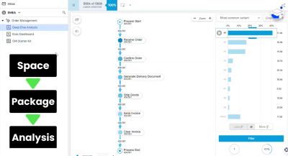
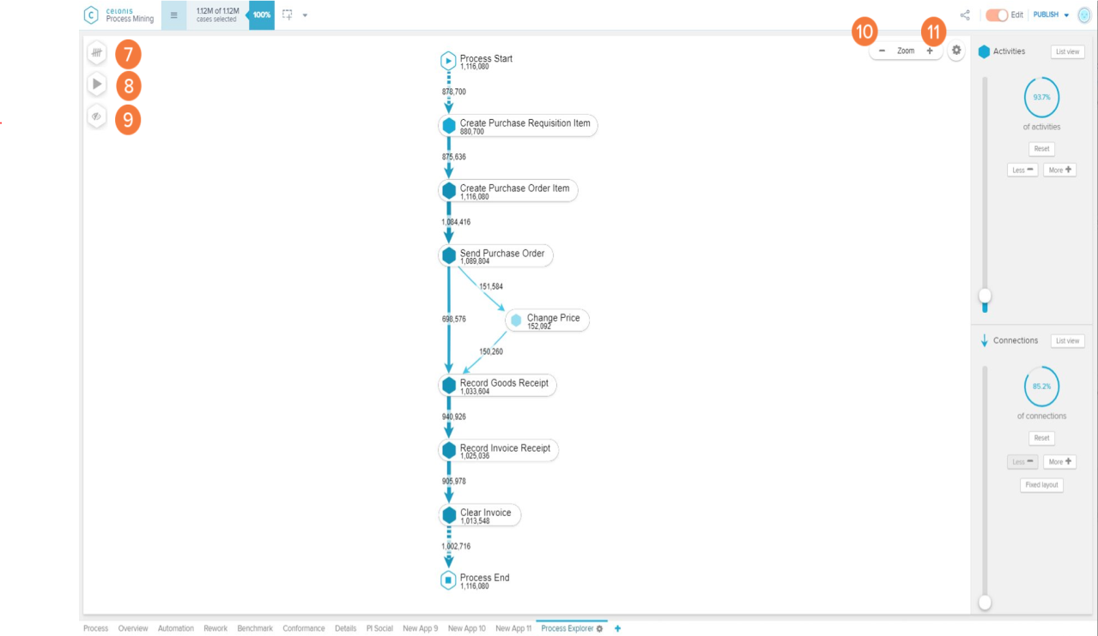
Contd..
Fig: Process Explorer Fig: Variant Explorer

Slide 16
Contd..
2.Variant Explorer is a concept often associated with process mining tools. It's a feature that allows users to explore and visualize the different variants or paths that a process can take based on the data extracted from event logs. Here's a closer look at what the Variant Explorer
1.Variant Identification: In any business process, there can be multiple ways that activities are executed due to exceptions, user behaviors, or different scenarios. The Variant Explorer identifies and presents these various paths, showing the deviations from the main or expected process flow.
2.Visualization:The Variant Explorer typically displays the different process variants in a user-friendly graphical format. It may use different colors, labels, or annotations to distinguish between the main process flow and its variants.
3. Frequency Analysis: The tool often provides information about how often each variant occurs in the event logs. This frequency analysis helps organizations understand the relative importance of different process paths.

Slide 17
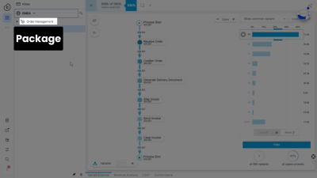
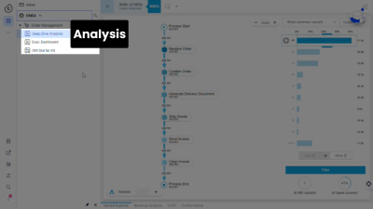
Contd..
In process mining, space, package, and analysis are three important concepts.
Space: Space refers to the additional information that can be used to enrich event logs, such as the location of the activities, the resources involved, or the organizational units.
Package: A package is a collection of assets in Process Mining. It can contain analyses, knowledge models, views, and skills.
Analysis: An analysis is a process mining artifact that is used to explore and analyze event logs. It can be used to discover process models, identify deviations from the model, and measure the performance of the process.

Slide 18
Contd..
3.Navigation analysis in process mining is a technique used to analyze the paths that users take through a process. It can be used to identify bottlenecks, inefficiencies, and opportunities for improvement.
Navigation analysis can be performed using a variety of techniques, including:
Frequency analysis: This involves counting the number of times each path is taken.
Conformance analysis: This involves comparing the actual paths taken to the ideal paths.
Deviation analysis: This involves identifying paths that are not in line with the ideal paths.
Heatmaps: This involves using color coding to show the frequency of paths. Process maps: This involves creating a graphical representation of the paths.
Here are some of the benefits of using navigation analysis in process mining:
It can help you to identify bottlenecks and inefficiencies in the process.
It can help you to find areas where the process can be improved.
It can help you to communicate the findings of the analysis to stakeholders.

Slide 19
Contd..
4.Charts and review KPL’s :
Visualizing KPIs using charts and tables is an effective way to understand process performance, identify trends, and make informed decisions. Here's how you can use charts and tables to review KPIs:
1.Bar Charts: Bar charts are useful for comparing different KPI values across categories. For instance, you can use a bar chart to compare the average processing time for different process steps. - Each bar represents a category (process step, department, time period), and the height of the bar corresponds to the value of the KPI.
2. Line Charts: Line charts are excellent for tracking trends over time. You can use them to visualize how KPIs change across different time periods. - For example, a line chart can show how the average response time for customer support requests changes from month to month.
3. Pie Charts: Pie charts are helpful for displaying the distribution of a whole into its components. You can use them to show the percentage breakdown of KPI values. - For instance, a pie chart can illustrate the distribution of resources allocated to different process steps.

Slide 20
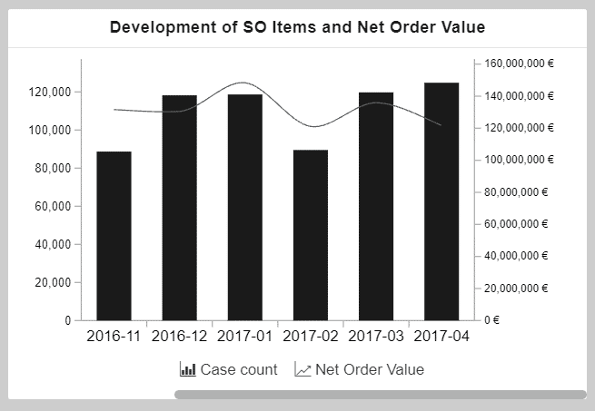
Contd..
Key Performance Indicators (KPIs) are used to calculate and add aggregated values; for example, case count, order value, invoice value, throughput time, and automation rate.
A dimension is a category of attributes; for example, the dimension "customer name" is a category for individual customer names. Other examples of dimensions, depending on the nature of the process, can include vendor name, sales organization, region, and material group.
This chart shows the development of sales order items (KPI)
and the corresponding net order value (KPI) over a period
of time (dimension).
The x-axis displays the dimension, the creation date of sales
order, grouped by months.The two y-axes display the KPIs:
The columns display the number of sales order items
(case count) and the line displays the net order value.

Slide 21
Contd..
5.Selection views in process mining are specialized visualizations that focus on specific aspects of a process or its data. These views help users narrow down their analysis to relevant subsets of data and gain deeper insights into particular process characteristics. Selection views are especially useful when dealing with large event logs and complex processes. Here are some common types of selection views used in process mining:
1.Activity Views: Activity-based selection views allow you to filter the analysis to a particular activity or set of activities within the process. This can help you understand how specific activities impact overall process flow and performance.
2.Resource Views: These views focus on specific resources (e.g., employees, machines) involved in the process. You can analyze how resources are allocated, their workload, and potential bottlenecks.
3.Performance Views: Performance-based selection views help you analyze process performance metrics, such as cycle times, waiting times, and throughput, in relation to specific segments of the process.

Slide 22
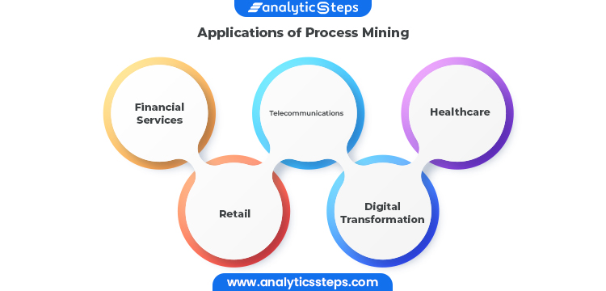
Real Time Application
Sales:Lead-To-Order
Reduced sales cycle time: Lead-to-order processes
can take a long time. This causes the payback time
of marketing investments to increase.
Companies can uncover the reasons behind this
issue and, take action to reduce sales cycle time.
Education
Online learning platforms: Process and task mining can reveal details on how users navigate on learning platforms to improve user experience for students. For example, process mining can show the potential root-causes behind students’ exit rates from the given platform, such as the length of videos or organization of materials.

Slide 23
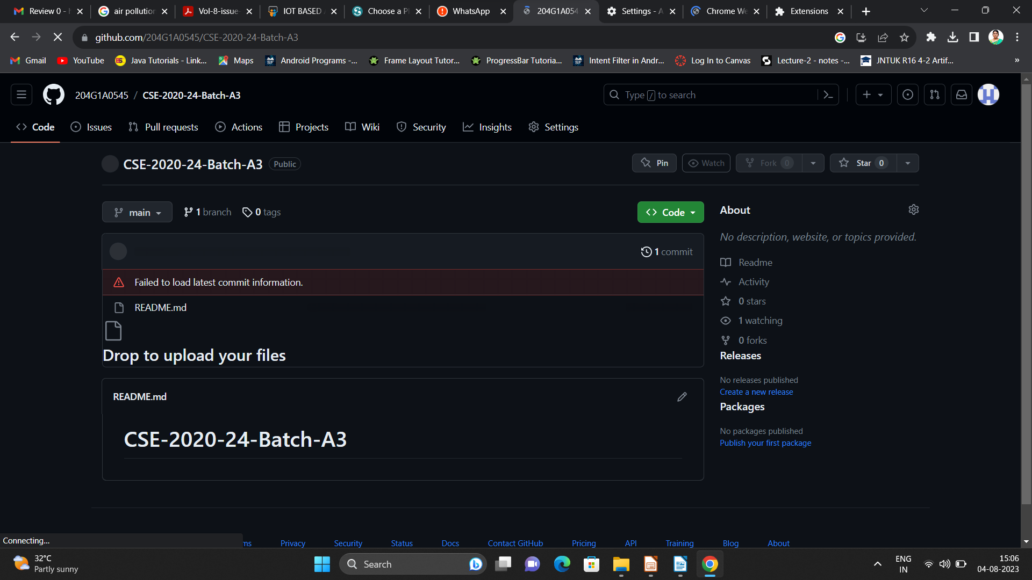

Git Hub Dashboard
Repository Name Like: Summer Internship - I
Under that include document, presentation and Certificate(Pdf).

Slide 24
Any Queries?

Slide 25
Thank You!!!

